Slide 1

FREELANCING WEBSITE
By - Jeetraj Soni
EN19CS301156

Slide 2
Introduction to MERN technology
MERN Stack is a collection of powerful technologies and robust, used to develop scalable master web applications comprising backend, front-end, and database components.
It is JavaScript that is used for the faster and easier development of full-stack web applications.
MERN Stack is a technology that is a user-friendly full-stack JavaScript framework for building applications and dynamic websites.

Slide 3
MERN concept
MERN Stack consists of four main components or can say four main technologies:
M stands for MongoDB ( Database ), mainly used for preparing document database and is a NoSQL (Non-Structured Query Language ) Database System
E stands for Express, mainly used for developing Node.js web framework
R stands for React, mainly used for developing a client-side JavaScript framework
N stands for js, mainly used for developing the premier JavaScript web server

Slide 4
MERN Stack for building Mobile and Web applications
Cost-effective
SEO friendly
Better performance
Improves Security
Provide the fastest delivery
Provides faster Modifications
Open Source
Easy to switch between client and server

Slide 5
Architectural framework of MERN stack
MERN has a 3-tier Architecture system mainly consisting of 3 layers -
These layers are as follows:
Web as front-end tier
Server as the middle tier
Database as backend tier

Slide 6
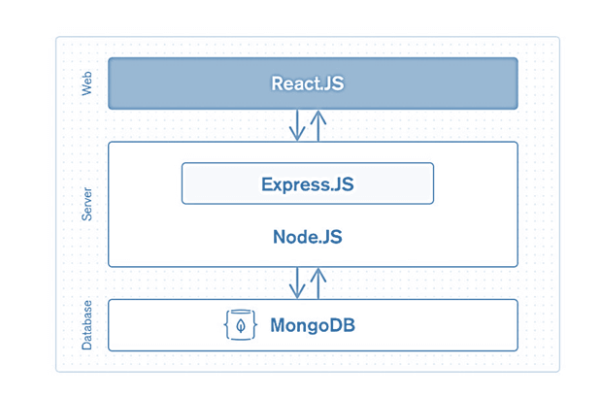

Slide 7
React JS- Front tier
The top tier of the MERN stack is mainly handled by React.js. It is one of the most prominent used open-source front-end JavaScript libraries used for building Web applications. It is famous for creating dynamic client-side applications. React will help you construct complex interfaces by using single components. It also connects those complex interfaces to data available on the backend server. React is used to create mobile applications (React Native) and web applications. React allows the reusability of code and can easily support it, which has many benefits and is much time saver. It permits users to create large web applications that can easily change the data of the page even without reloading the page.

Slide 8
Node and Express JS-Middle Tier
It is just next level from the top layer and is mainly handled by two components of the MERN stack, i.e., Express.js and Node.js. These two's components handle it simultaneously because Express.js maintained the Server-side framework, running inside the Node.js server. Express.js is one of the widely used backend development JavaScript Frameworks. It allows developers to spin up robust APIs (Application Programming Interface) and web servers much easier and simpler. It also adds helpful functionalities to Node.js HTTP (Hypertext Transfer Protocol) objects. Whereas on the other hand, Node.js plays a very important role in itself. It is an open-source server environment, and it is a cross-platform runtime environment for executing JavaScript code outside a browser. Node.js continuously uses JavaScript; thus, it's ultimately helpful for a computer user to quickly create any net service or any net or mobile application.

Slide 9
MongoDB- Database Tier
It is one of the most important levels of the MERN Stack and is mainly handled by MongoDB; the main role of a database is to store all the data related to your application, for example - content, statistics, information, user profiles, comments and so on. It mainly stores all the data for safety purposes. It maintains a proper record, which usually returns the data to the user whenever required. It mainly stores the data in the database. It generates two or more replica files of the data so that whenever the system fails, it can retrieve the exact information or data that the user wanted earlier. It implies that MongoDB is not based on the table-like relational database structure. On the other hand, it provides an altogether different mechanism for the retrieval and storage of data. Mongo DB is the most popular NoSQL (NoSQL or Non Structured Query Language) database, an open-source document-oriented database. The term 'NoSQL' typically means a non-relational database that does not require a fixed schema or proper relational tables to store the necessary data in it. MongoDB stores the data in a different format other than the relational tables, consisting of rows and columns.

Slide 10
Project Overview
Abstract
A freelancer is a self-employed person who offers services, often working on several jobs for various clients at a time. Freelancers usually make money on a per-task basis, charging hourly or daily rates for their work. Freelance work is usually for the short-term.
Freelancing is a contract-based profession where you use your skills, education, and experience to work with multiple clients and take on various tasks. Freelancing usually involves jobs that allow you to work-from-home. It is just that many of the jobs that freelancers perform can be delivered over the internet without their presence at the company or client’s place.

Slide 11
Objective and Functionalities:
The main functionalities include:
• Make some extra money
• You don’t need to bid your service
• Opportunity to challenge yourself and broaden your skills
• We will bring you paying buyers
•No limitations over bidding
• You can apply for multiple works at one time from any domain.

Slide 12
Features:
• Product and Component based
• Creating & Changing topics at ease
• Query Issue List to any depth
• Reporting & Charting in more comprehensive way
• User Accounts to control the access and maintain security
• Simple Status & Resolutions
• Multi-level Priorities & Severities.
• Targets & Milestones for guiding the programmers
• Robust database back-end

Slide 13
EXISTING SYSTEM
If you are just starting as a freelancer in Fiverr, it can be hard to get your first few gigs. There are a lot of freelancers in Fiverr, which means you are competing with thousands of other sellers or freelancers. The Fiverr algorithm pushes freelancers who have good reviews up in their search engines when clients search for freelancers. This makes it difficult for beginners to land gigs because most clients don’t want to take chances on you when they can just hire another who already has a proven track record.

Slide 14
DISADVANTAGES OF EXISTING SYSTEM
Another downside of Fiverr is that you are basically at the mercy of the platform. They have strict policies that you should comply with. Such policies include the prohibition on contacting people outside Fiverr. Therefore, you can’t build a list of repeat clients or buyers as your network outside the platform because they can deactivate your account. Fiverr also has the right to raise their commission rate for as much as they want without your consent or approval.

Slide 15
PROPOSED SYSTEM
There are many categories where products and services are offered on this platform. Everything from logo design, music, writing, virtual assisting, etc. is all available, which is good because you can choose gigs in your interests. You can work with different projects and deal with different people. It gives you the opportunity to practice handling clients and to meet their project needs.
You can make a decent amount of money working on part-time doing freelancing jobs in our app. The rate is pretty bit low compared with other platforms like Upwork. Most of the gig image size that you will see cost five dollars, but we also charged you one dollar for using their platform.

Slide 16
SYSTEM ANALYSIS
This project is used by 3 types of users (modules).
1)Online Users
2)Employers
3)Administrator

Slide 17
USER MODULE
Check work availability.
Fill registration form.
Can login with his/her own user id and password.
Get facilities of Different Kind of work and projects.
Get the information about Featured project or urgent work.
Get information about real time status of project.
Can regenerate password if he/she forgets the password.

Slide 18
ADMINISTRATOR MODULE
Can login with unique user id and password.
Check details of project reserved for the current day as well as coming days.
Can Update/Delete projects From System.
Can Control Admin Dashboard.

Slide 19
EMPLOYER MODULE
Upload work availability.
Fill registration form.
Can login with his/her own user id and password.
Create facilities of Different Kind of work and projects.
Get information about real time status of project.
Can regenerate password if he/she forgets the password.

Slide 20
DESIGN CONSTRAINTS
SOFTWARE CONSTRAINTS
OPERATING SYSTEM – WINDOWS/LINUX/Android
DATABASE – Mongo Compass
PLATFORM – Any Web Browser
TECHNOLOGY – MERN Stcak
HARDWARE CONSTRAINTS
Ram – 30 Mb per user Session

Slide 21
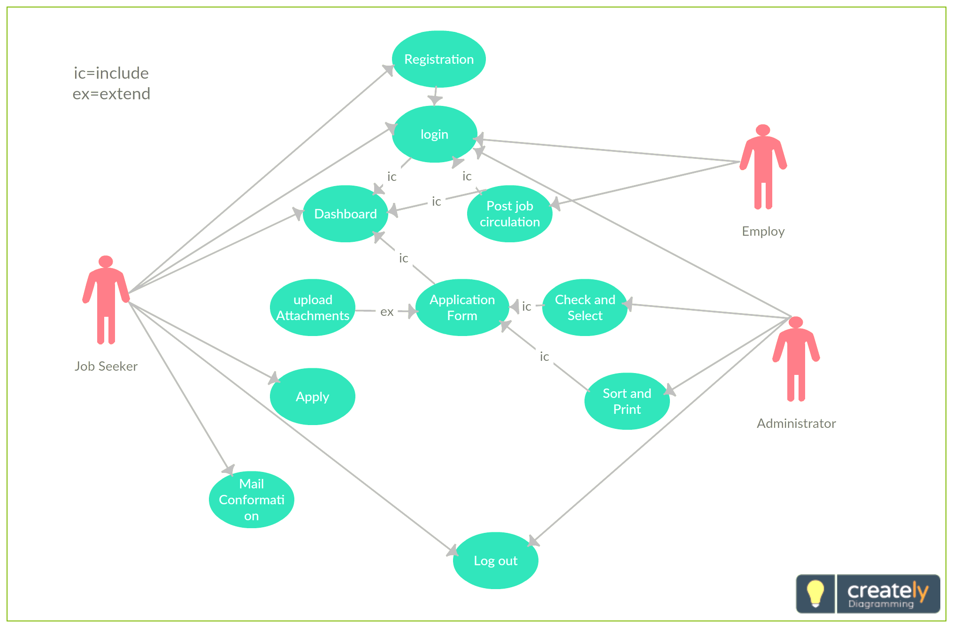
Use Case Diagram for User:-

Slide 22
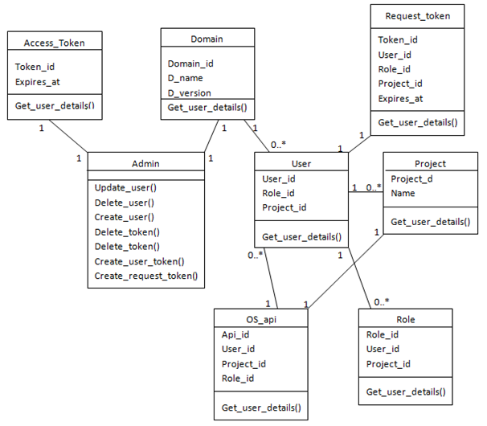
Class diagram for the System:-

Slide 23
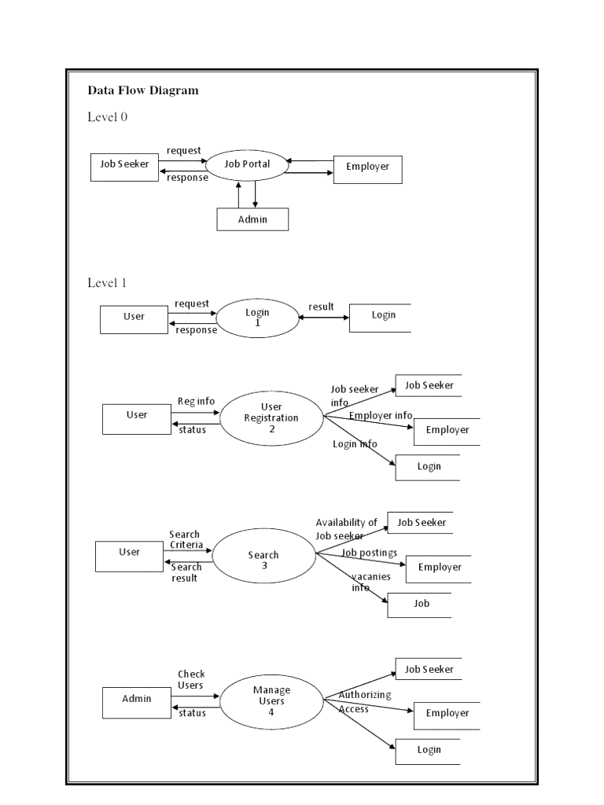
DFD diagram for the System:-

Slide 24
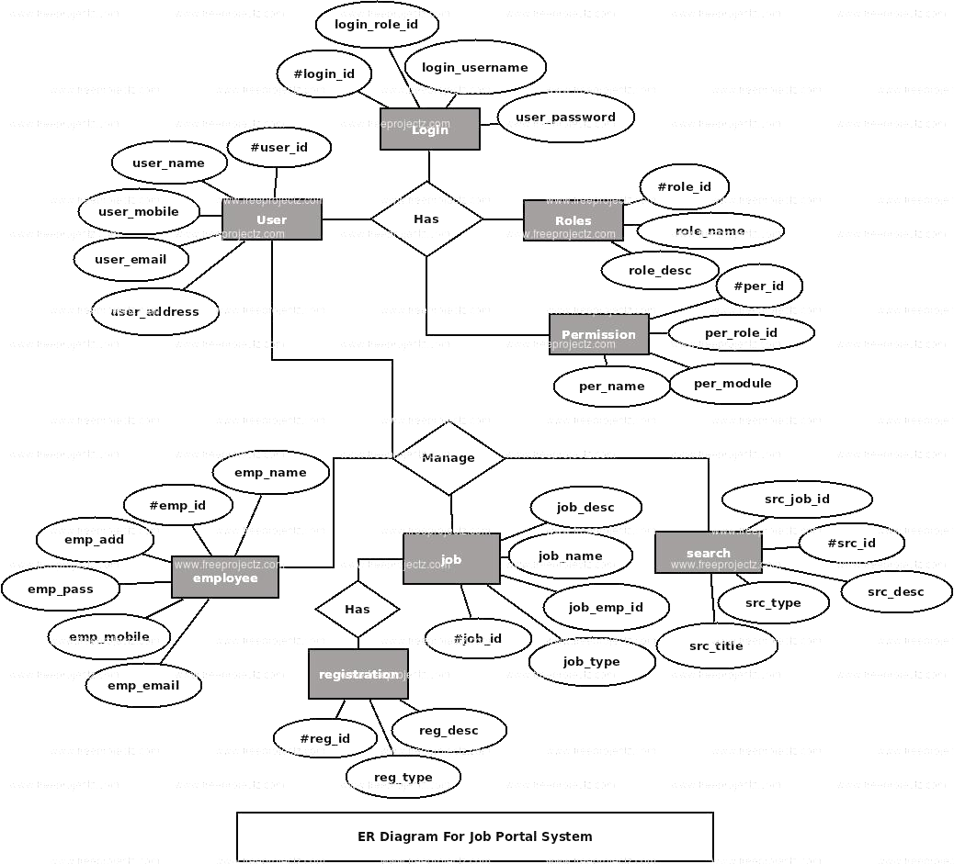
ER diagram for the System:-

Slide 25
System Requirement Specification
The proposed system has the following requirements:
• System needs store information about new entry of project.
• System needs to help the freelancers to keep information of project and find them as per various queries.
• System need to maintain quantity record.
• System need to keep the record of Services.
• System need to update and delete the record.
• System also needs a search area.
• It also needs a security system to prevent data

Slide 26
Conclusion
At the end it is concluded that we have made effort on following points…
• A description of the background and context of the project and its relation to work already done in the area.
• Made statement of the aims and objectives of the project.
• We define the problem on which we are working in the project.
• We describe the requirement Specifications of the system and the actions that can be done on these things.
• We understand the problem domain and produce a model of the system, which describes operations that can be performed on the system.
• We designed user interface and security issues related to system.

